Slide 1
My day at the Science Festival
By Hector Rowe

Slide 2
First I went to give my tickets to the lady.

Slide 3
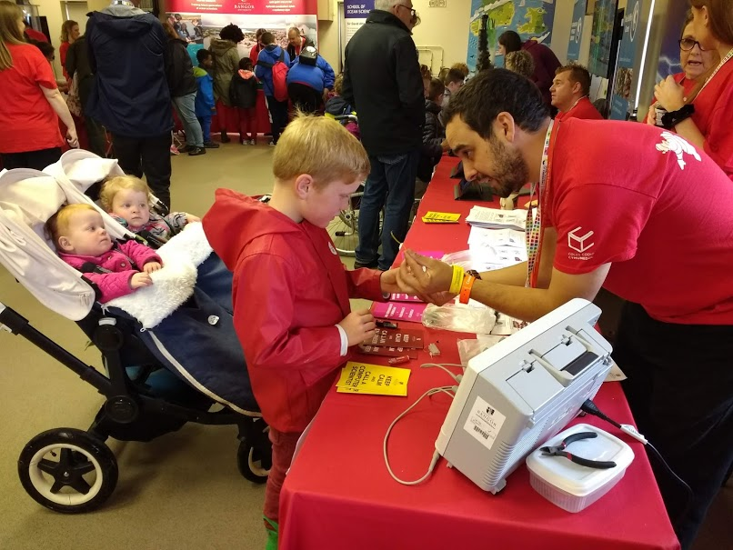
Then I went to the building and made a circuit.

Slide 4
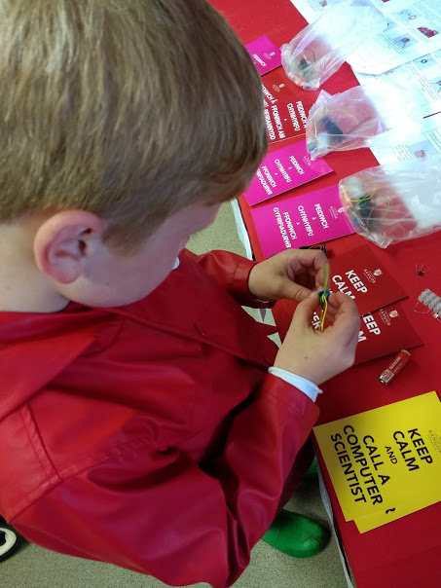
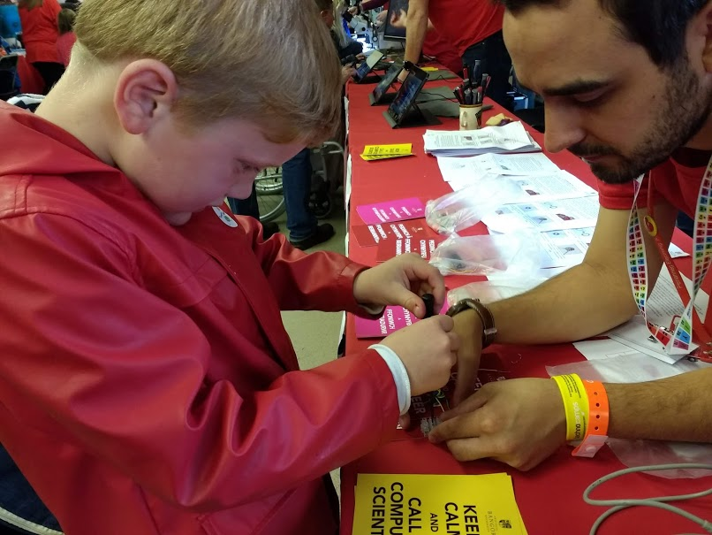
Making circuits (continued)……

Slide 5
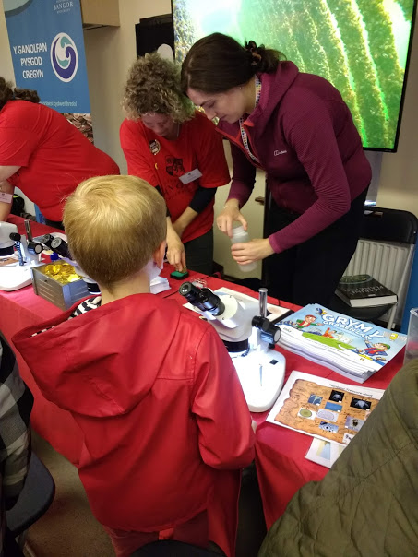
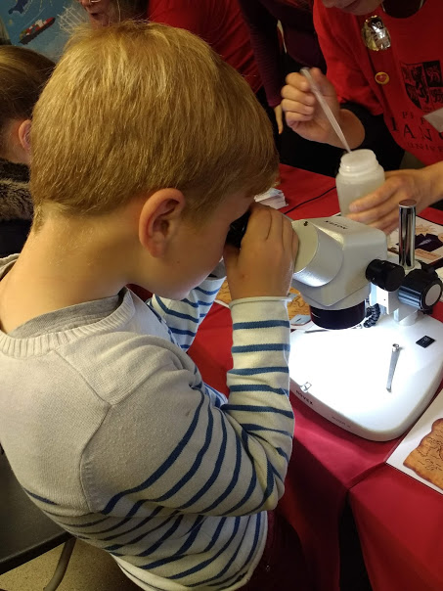
After this I looked at sea creatures through a microscope.

Slide 6
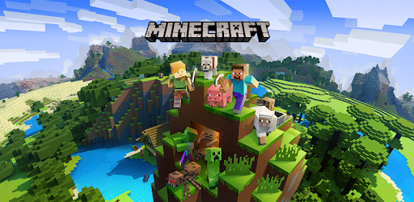
Then I went to play Minecraft.

Slide 7
Next I went to the Technocamps stand. I played with the Lego turbine and got a Technocamps USB and a pencilcase.

Slide 8
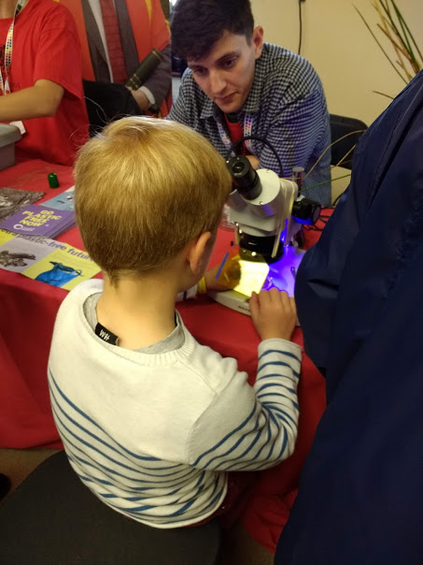
Afterwards I looked through the microscope at sea plastic that was found on the beach.

Slide 9
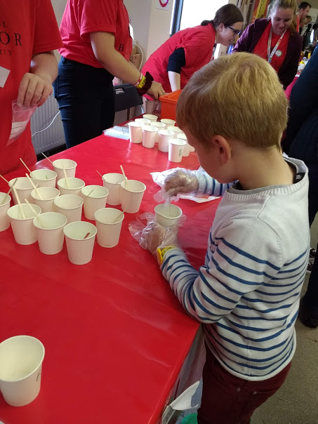
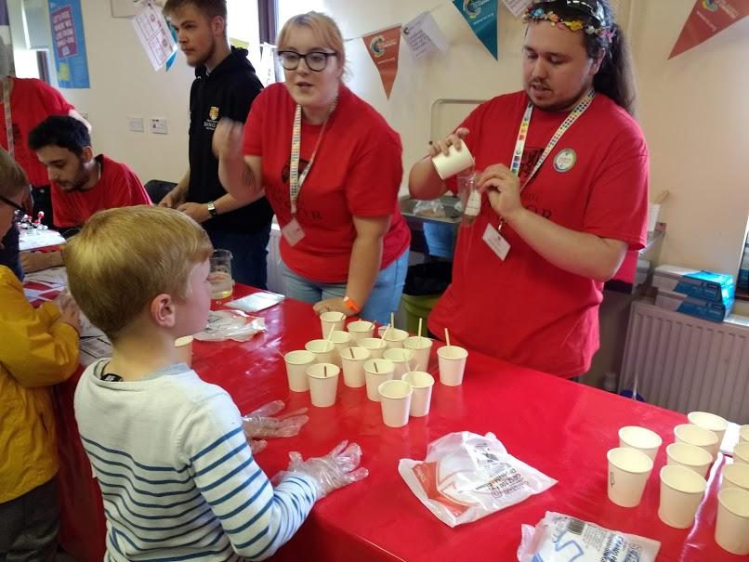
Next I made slime from PVA glue and borax. I chose to make green slime.

Slide 10
Then I played a game where you had to move circles from one side to the other side. You couldn’t put a big one on a small one, otherwise it would squish it. But, you could put a small one on a big one. You could only move one circle at a time and it was easy to start with but then it got hard.

Slide 11
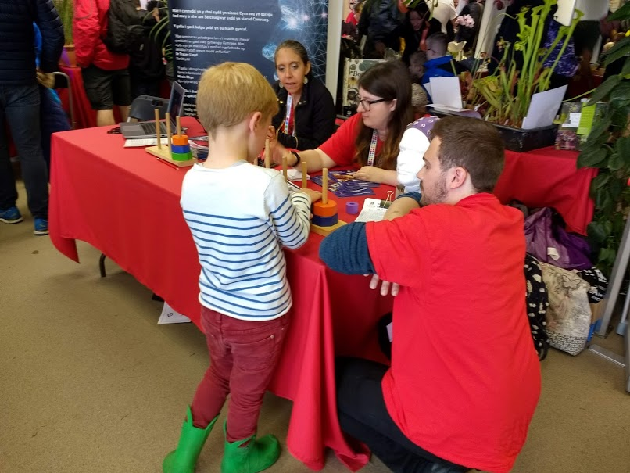

Slide 12
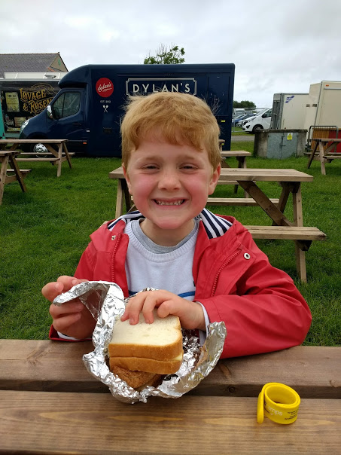
After this we had our lunch. It was very windy!

Slide 13
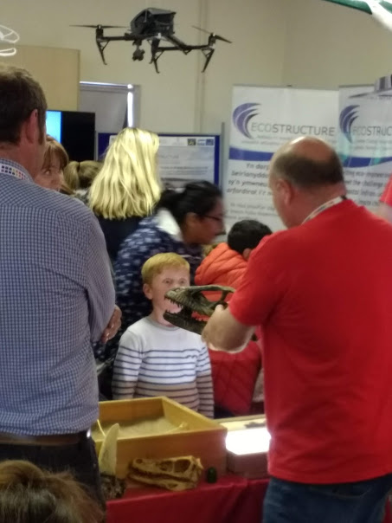
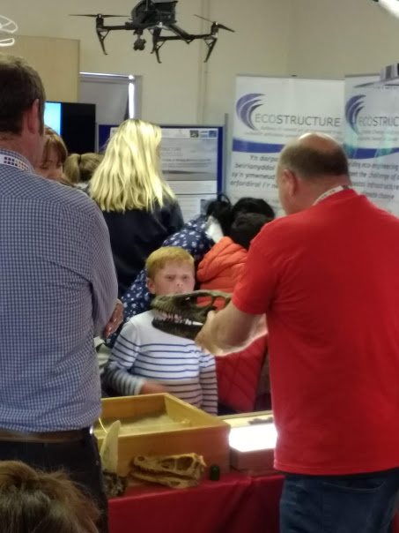
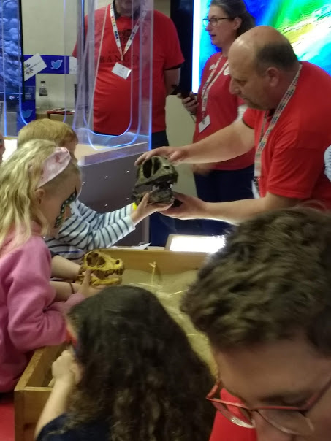
After lunch I looked at some fossils and I held a velociraptor skull and a bigger dinosaur skull.

Slide 14
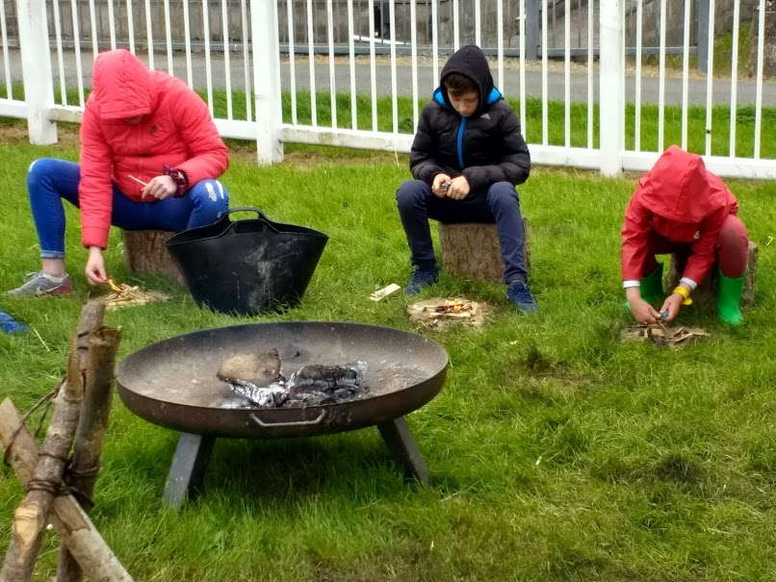
Then we went outside and went for a walk. I did some bush craft and tried to light a fire but it was hard and too windy so it kept blowing out.

Slide 15
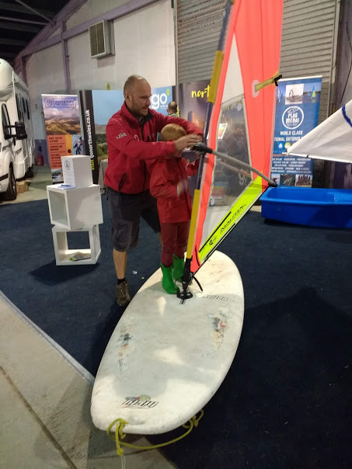
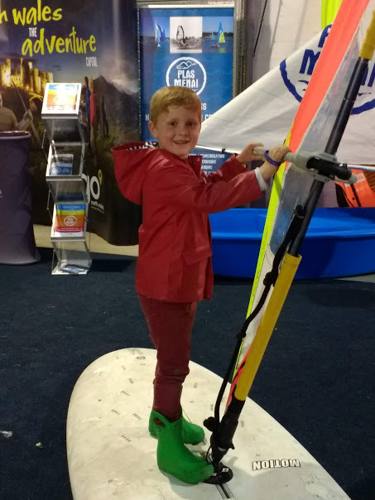
When we were inside, I tried standing on a windsurf.

Slide 16
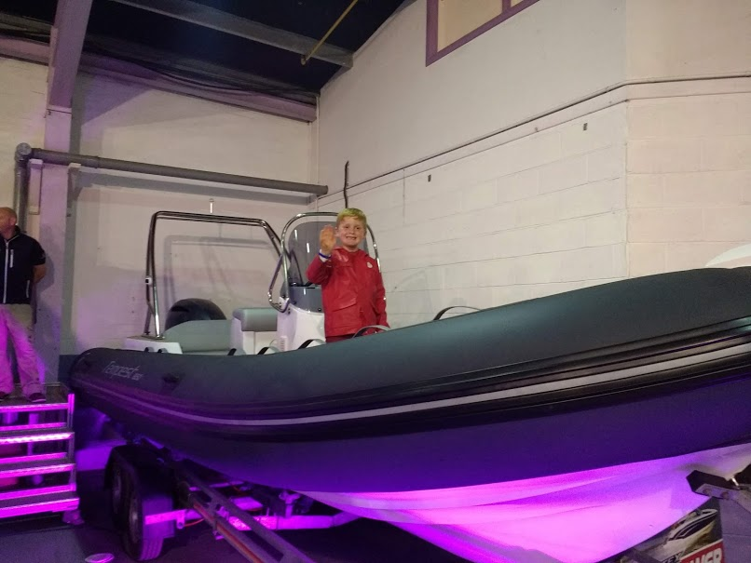
After this we went inside and looked at the boats. I climbed on some of them. They were very big!

Slide 17
I really enjoyed myself at the Science Festival.

